Slide 1


2026 Budget Overview
Turn90

Slide 2

Recommended Action: Approve 2025 operating budget of $4.33M in total expenses with $3.1M in projected revenue.
Turn90’s FY2026 budget reflects a bridge year, one where Turn90 sustains its full program delivery while earned revenue grows into the cost structure that is now fully built. This is the organization’s first full year of operations across all three centers. This is a deliberate, stabilization-year budget that carries a planned deficit, reflecting the full operational cost of running the complete model while Industrial Services revenue continues to scale.

Slide 3
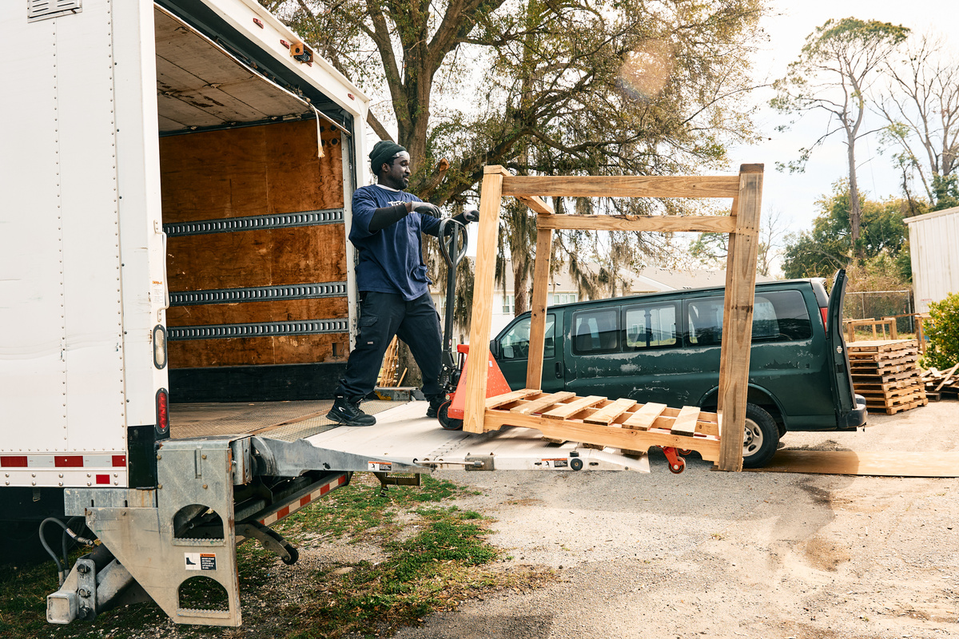
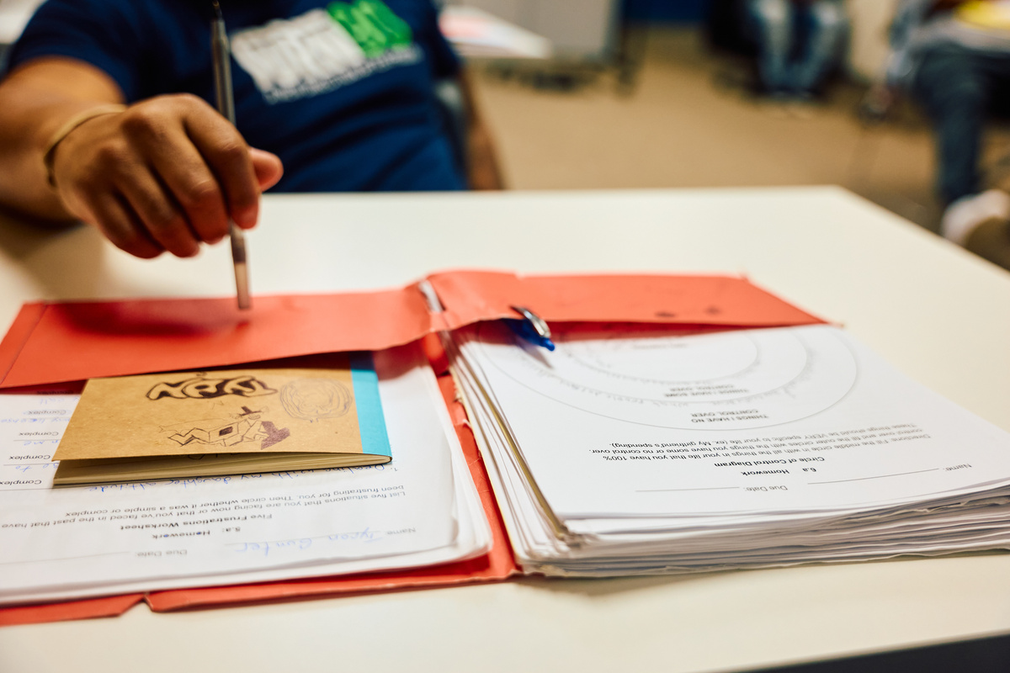
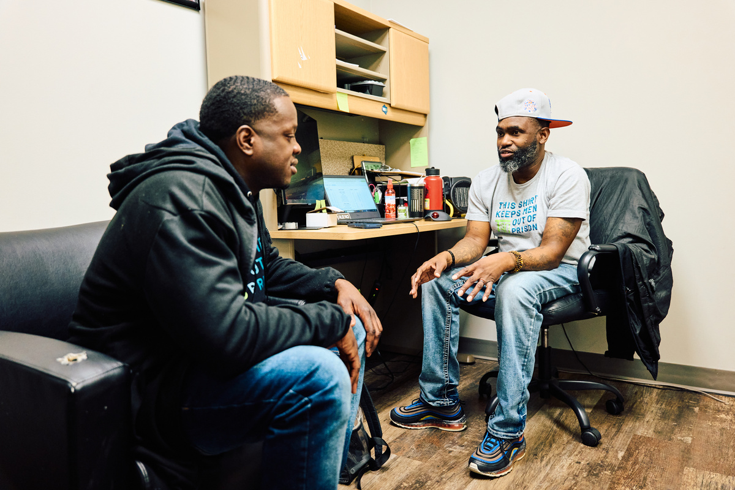
Revenue Generation
Industrial Services
Philanthropy Efforts
State Funding
Focused on achieving $800K revenue growth.
Philanthropic support targets $900K for impact.
If secured funding expected to generate an addtional $375K.

Slide 4
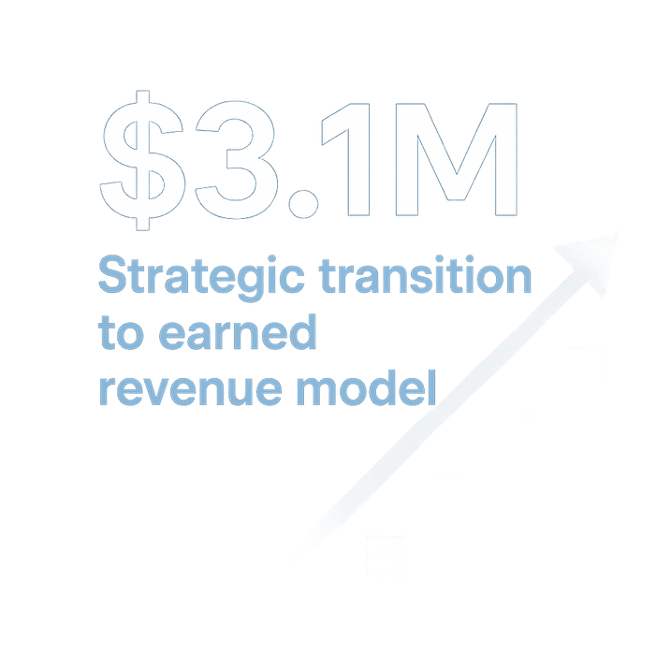
2026 REVENUE BUDGET
 | 2026 BUDGET | 2024 ACTUAL | 2025 EOY FORECAST | DELTA (2026 / 2025)
CONTRIBUTED REVENUE | CONTRIBUTED REVENUE | CONTRIBUTED REVENUE | CONTRIBUTED REVENUE | CONTRIBUTED REVENUE
Individual Contributions | $792,750 | $405,799 | $696.025 | $96,725
Board Contributions | $51,500 | $44,662 | $58,078 | $(6,578)
Corporate Contributions | $10,000 | $8,704 | $8,031 | $1,969
Nonprofit & Foundation Contributions | $45,750 | $44,617 | $95,585 | $(47,835)
Subtotal Contributed Revenue | $900,000 | $503,781 | $855,718 | $44,282
GRANT REVENUE | GRANT REVENUE | GRANT REVENUE | GRANT REVENUE | GRANT REVENUE
Grants with Restrictions | $485,000 | $291,500 | $483,214 | $1,786
Grants without Restrictions | $15,000 | $2,018,500 | $21,100 | $(6,100)
Subtotal Grant Revenue | $500,000 | $2,310,000 | $504,314 | ($4,314)
GOVERNMENT GRANTS | GOVERNMENT GRANTS | GOVERNMENT GRANTS | GOVERNMENT GRANTS | GOVERNMENT GRANTS
Local Government Grants | $85,000 | $85,000 | $85,000 | $ -
State Grants | $ - | $500,000 | $ - | $ -
Subtotal Government Grants | $85,000 | $585,000 | $85,000 | $ -
BUSINESS REVENUE | BUSINESS REVENUE | BUSINESS REVENUE | BUSINESS REVENUE | BUSINESS REVENUE
Print Shop | $700,000 | $900,339 | $858,299 | ($158,299)
Industrial Services | $798,000 | $81,068 | $127,302 | $670,698
Subtotal Business Revenue | $1,498,000 | $981,407 | $985,601 | $512,399
INVESTMENT INCOME
Investment income | $120,000 | $180,934 | $143,375 | $(23,375)
Subtotal Investment Income | $120,000 | $180,934 | $143,375 | ($23,375)
Total Revenue | $3,103,000 | $4,561,122 | $2,574,008 | $528,992

Slide 5
01
02
03
Contract timing delays: Industrial services contracts are pipeline-dependent with variable start dates.
Impact: Could shift revenue between quarters or into 2027
Mitigation:
Active pipeline management and business development focus
Excess capacity exists at all three locations (no incremental hiring needed)
Can absorb contracts quickly when they materialize
Fundraising Dependency: Closing the budget gap will require fundraising windfall
Impact: $1.2M gap between revenue and expenses
Mitigation:
State grant application pending (earmark opportunity if legislature opens process)
Historical success rate with grant funding
Diversified funding strategy across government and private sources
Accounting Infrastructure Costs: Current accounting arrangement under review; final 2025 costs uncertain
Impact: Potential variance of $30-50K from budgeted $108K
Mitigation:
Budget includes adequate contingency
Decision will be made by year-end based on service provider proposals
Board will be notified of any material changes
04
Operating Expense Variance: Multi-location operations with program and manufacturing components carry execution risk
Impact: Potential for cost overruns in facilities, labor, or COGS
Mitigation:
Proven track record of coming under budget annually
Monthly financial review and variance analysis
Clear approval processes for unbudgeted expenses
Finance committee oversight
RISKS

Slide 6
01
02
03
Industrial Services Revenue Acceleration
Upside Potential: $200-300K above projections
Drivers:
Strong pipeline of manufacturing prospects
Excess capacity at all locations
Established relationships with anchor clients (e.g., AFL, Cummins)
Competitive labor model
Growing market demand for domestic light manufacturing
Probability: Moderate to High
State Grant Funding
Upside Potential: $375,000
Drivers:
Proven program outcomes and reentry success rates
Bipartisan support for workforce development and reentry initiatives
Strong relationship with SC Dept of Corrections
Addresses critical state priorities (workforce, recidivism reduction)
Probability: Moderate (dependent on legislative earmark process opening)
Foundation Partnership
Upside Potential: TBD
Drivers:
Large foundation prospect identified and in active cultivation
Probability: Moderate
04
Expense Efficiency Gains
Upside Potential: $50k
Drivers:
Historical pattern of operating 3-5% under budget
Process improvements and systems optimization ongoing
Economies of scale as industrial services volume grows
Strategic vendor relationships and the staff needed to manage
Probability: High
Opportunities

Slide 7
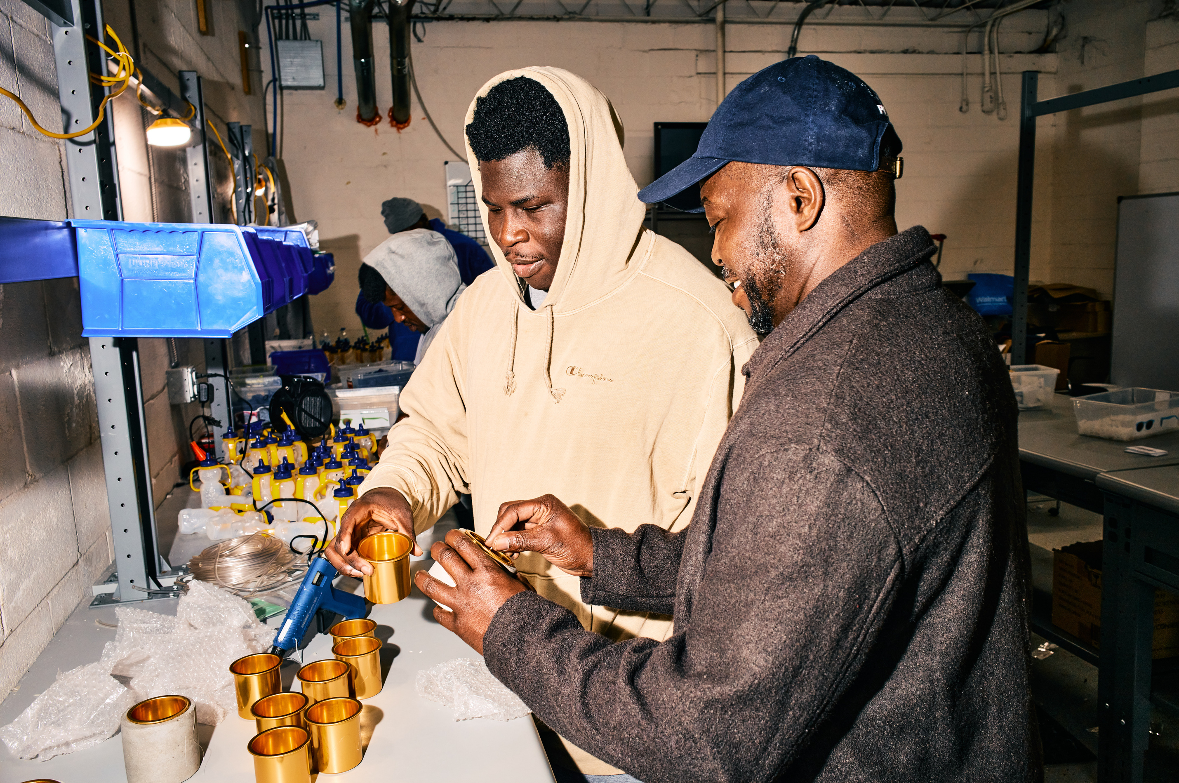
Industrial Services
Scaling for Sustained Growth
Revenue Target
We aim to grow from $150K in FY25 to $800K in FY26, leveraging existing contracts and effectively expanding our client base.
Strategic Contracts
Growth with existing partners and the upcoming Cummins Turbo project will significantly boost revenue, with expected runs driving utilization in Q2.
Focused Sales Plan
Our sales team is well equipped with the tools needed to execute the sales plan and our network grows everyday.

Slide 8
2026 Finance Committee Activities
1
Industrial Services Analytics
2
Comprehensive capacity and productivity model development
3
Pricing strategy refinement
4
Contribution margin analysis by contract type
5
Scalability planning

Slide 9
INDUSTRIAL SERVICES CONTRACTS - 2026 | INDUSTRIAL SERVICES CONTRACTS - 2026 | INDUSTRIAL SERVICES CONTRACTS - 2026 | INDUSTRIAL SERVICES CONTRACTS - 2026 | INDUSTRIAL SERVICES CONTRACTS - 2026 | INDUSTRIAL SERVICES CONTRACTS - 2026 | INDUSTRIAL SERVICES CONTRACTS - 2026 | INDUSTRIAL SERVICES CONTRACTS - 2026 | INDUSTRIAL SERVICES CONTRACTS - 2026 | INDUSTRIAL SERVICES CONTRACTS - 2026
Client | Location | Service Type | Base Case | Top Case | Budget (Mid) | Margin % | Status | Start Date | Notes
Cummins Turbo | Charleston | Speed Sensor Refurbishment | $300,000 | $600,000 | $400,000 |  | Negotiating | Q2 2026 | $12/unit, 280/wk
Smithey Ironworks | Charleston | Lid Assembly/Packaging (Pilot) | $40,000 | $100,000 | $50,000 |  | Pilot Started | Q4 2025 | $.50/lid, 46,000 annually
Allegiance Flags | Charleston | Assembly/Packaging | $44,000 | $75,000 | $59,500 |  | Ongoing Contract | Q4 2024 | Brackets, Spinners, Tags
Allegiance Flags | Charleston | Aluminum Flag Pole Assembly | - | - | - |  | New Project | Q1 2026
TalkTools | Charleston | Assembly/Packaging | $22,000 | $30,000 | $26,000 |  | Ongoing Contract | Q1 2026 | Simple but reliable kitting
Meridian Metals | Charleston | Kevlar Reclamation |  |  |  |  | Closing |  | Conclude Q1 2026
CHS Opportunity | Charleston | TBD | $25,000 | $50,000 | $37,500 |  | Opportunity | Q2 2026
AFL | Charleston | Deadend Assembly | $50,000 | $200,000 | $125,000 |  | Positive pilot review | Q3 2025
AFL | Spartanburg | Tapcon Assembly |  |  |  |  | New Project | Q1 2026
PolyDeck | Spartanburg | Material Prep |  |  |  |  | Time Study | Q4 2025 | New Project / Exploratory
Cola Opp #1 | Columbia | TBD | $25,000 | $50,000 | $37,500 |  | Opportunity | Q2-Q3 | Critical for location
Cola Opp #2 | Columbia | TBD | $25,000 | $50,000 | $37,500 |  | Opportunity | Q2-Q3
SPB Opportunity | Spartanburg | TBD | $25,000 | $50,000 | $37,500 |  | Opportunity | Q3-Q4
TOTAL |  |  | $556,000 | $1,205,000 | $810,500

Slide 10

2026 Expense Budget
Talent Retention & Growth
Mission Support
Operational Excellence
A balanced approach with 3% cost-of-living adjustments and full benefits ensures operational effectiveness, maintains team stability, and supports execution of our growth strategy across three locations.
Budget supports both CBT and workforce development programming critical to business operations, with staffing levels adequate to serve 100+ program participants annually while executing commercial manufacturing contracts.
$4.3M total investment includes salaries ($3.1M), facilities ($412K), contract services ($190K), and cost of goods sold ($356K), positioning Turn90 for sustainable growth while maintaining program quality.

Slide 11
Metric | 2026 Value | Benchmark
Payroll-to-Total Expense | 70.70% | (Typical nonprofit workforce-heavy model: 65–75%)
Occupancy-to-Total Expense | 9.40% | (Within efficient range of 8–12%)
COGS-to-Total Expense | 8.80% | (Improving year-over-year due to IS margin mix)
Admin + Overhead | <10% | (Strong nonprofit efficiency)
Key Ratios
Indicators of a healthy employment social enterprise

Slide 12
2026 Expenses
 | 2026 Operations | 2024 | 2025 EOY Forecast | Delta (2025 - 2026)
2026 EXPENSES | 2026 EXPENSES | 2026 EXPENSES | 2026 EXPENSES | 2026 EXPENSES
Contract Service Expenses | $190,094 | $271,847 | $212,647 | $ (22,553)
Facility Expenses | $412,139 | $148,412 | $360,417 | $51,723
Grants & Direct Assistance | $34,500 | $18,700 | $32,014 | $2,486
Non-personnel Expenses | $142,587 | $88,742 | $160,567 | $ (17,981)
Other Expenses | $43,611 | $93,409 | $59,927 | $ (16,316)
Other Program Specific Expenses | $12,221 | $15,277 | $13,570 | $ (1,349)
Salaries & Related Expenses | $3,056,276 | $2,082,983 | $2,485,119 | $571,156
Travel & Conference Expenses | $34,676 | $29,527 | $37,080 | $ (2,404)
2026 Expenses Subtotal | $3,926,104 | $2,748,897 | $3,361,341 | $564,763
CAPITAL EXPENDITURE | CAPITAL EXPENDITURE | CAPITAL EXPENDITURE | CAPITAL EXPENDITURE | CAPITAL EXPENDITURE
Furniture & Workstations | $10,000 |  |  | $10,000
Leasehold Improvements | $25,000 |  |  | $25,000
CapEx Subtotal | $35,000 | $ - | $ - | $35,000
COGS | COGS | COGS | COGS | COGS
Industrial Services Direct Costs | $13,320 | $2,479 | $4,000 | $9,320
Print Shop Cost of Goods Sold | $342,792 | $415,968 | $423,215 | $ (80,423)
COGS Subtotal | $356,112 | $418,447 | $427,215 | $(71,103)
Grand Total | $4,317,216 | $3,167,344 | $3,788,556 | $528,660
The 2026 budget sits at a pivotal point between Turn90’s growth phase and sustainability phase.
The organization now carries the full cost of its model while revenue growth is still catching up.
This is not a structural problem but the natural lag between expansion and earned revenue realization.

Slide 13
Cash Outlook
Monitoring
Reforecasting
Capacity
Monthly tracking ensures we know when to take action.
Quarterly updates adjust forecasts based on performance.
Understand our peak performance and use strategic engagement and diligent networking to grow our businesses.

Slide 14
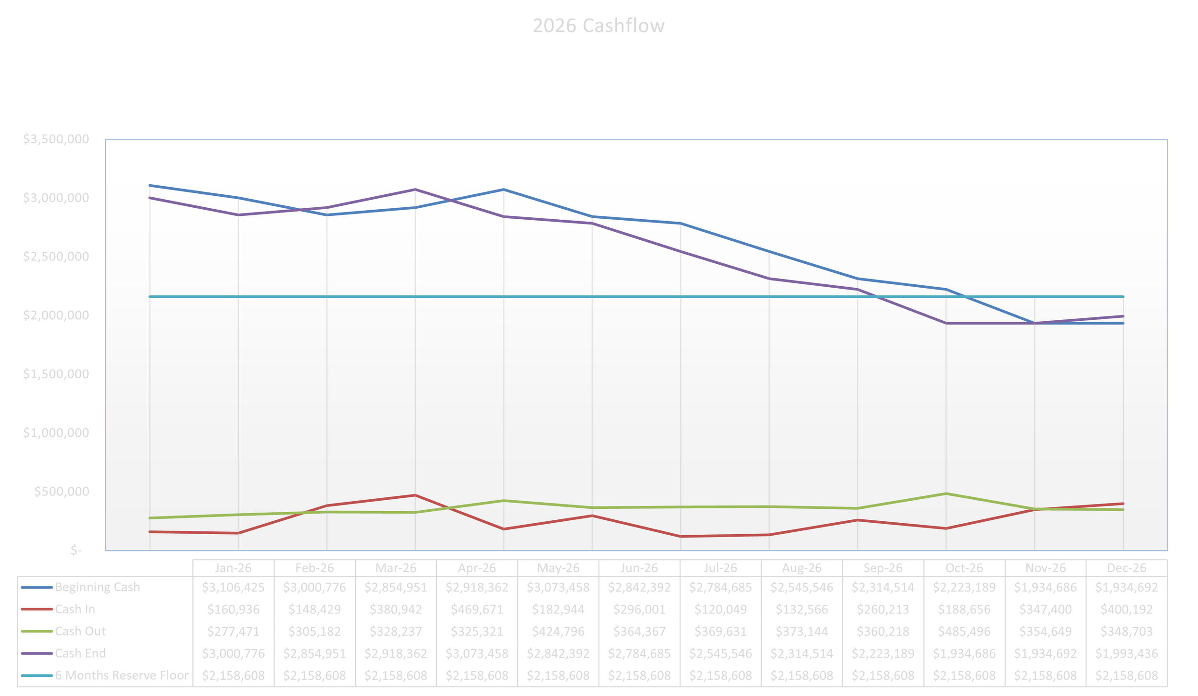

Slide 15
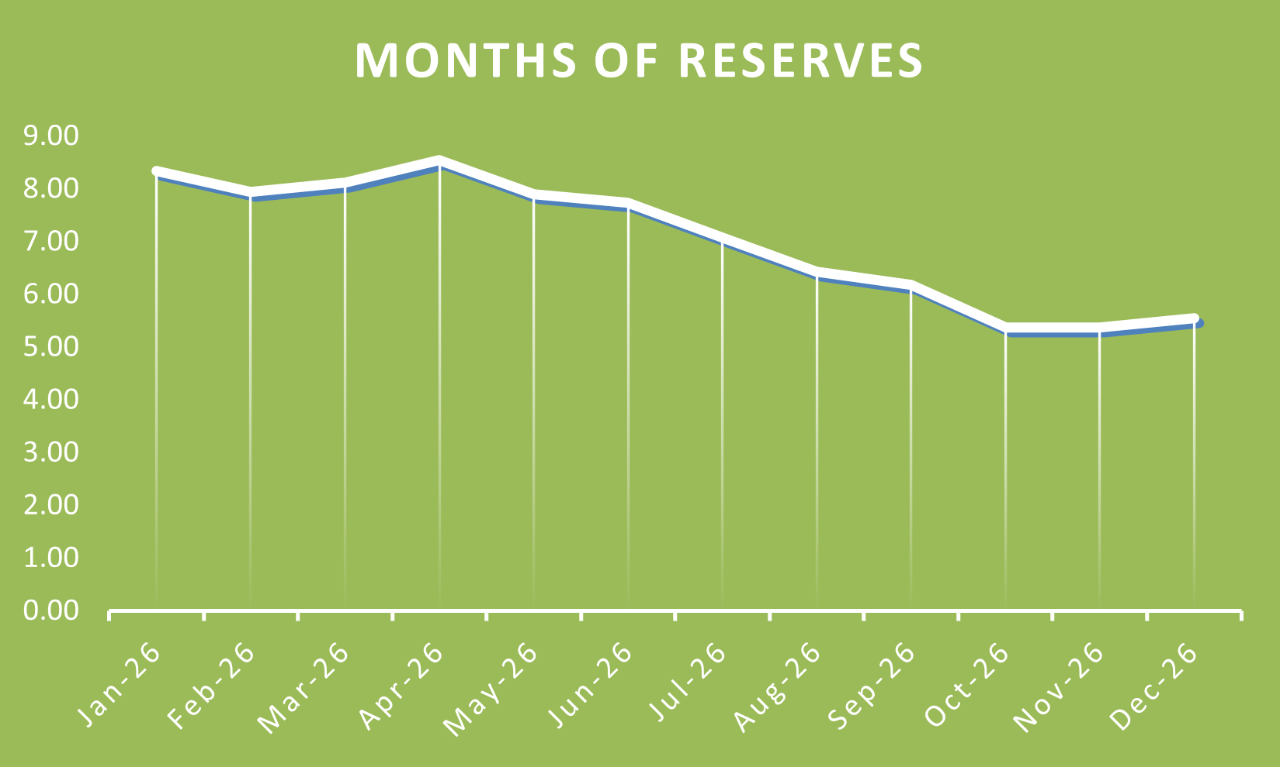

Slide 16

Finance Committee Recommendation
The Finance Committee has reviewed this budget in detail and recommends board approval with the following observations:
✓ Revenue projections are achievable based on current pipeline and fundraising prospects
✓ Expense budget is prudent and reflects organizational discipline
✓ Cash position is manageable through 2025 with appropriate monitoring
✓ Strategic focus is correct - prioritizing revenue before optimization
⚠ Execution is critical - requires strong business development performance and expense control
⚠ Monthly monitoring essential - Finance Committee will provide quarterly updates to full board

